Slide 1
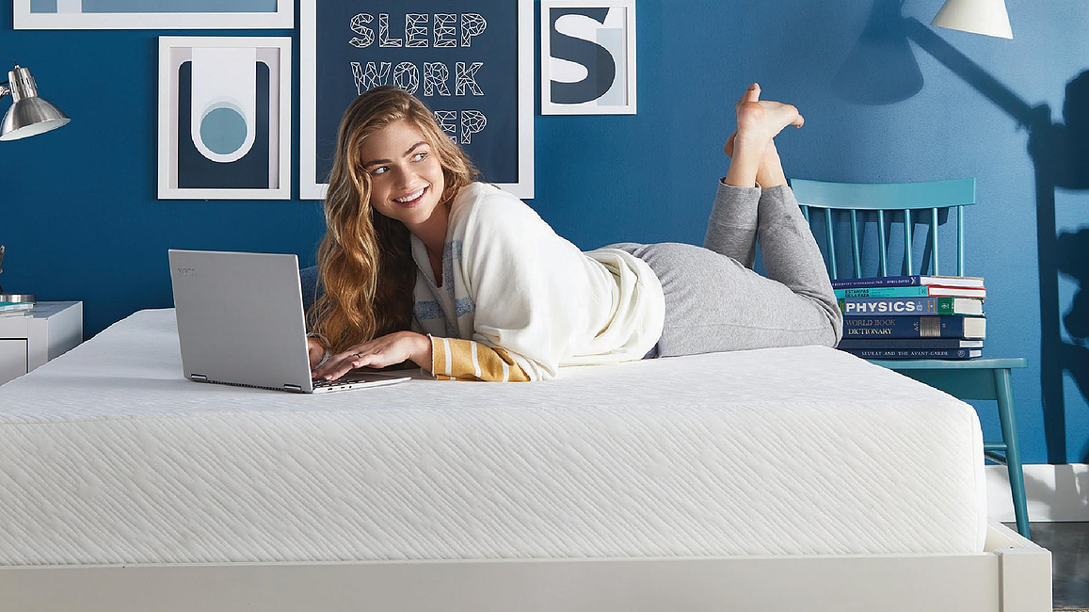
Sleep Cool Acquisition Analysis
Yuying Chen, Nikhil Cherukuri, Felix Cruz-Montanez, Jessie Lam, Ting-Chun Lin, Colin Petitt

Slide 2
Executive Summary
We recommend that Best Rest should target prior customers, those with higher incomes, and those who have previously bought a mattress online
Customers who have previously owned a Best Rest Mattress, have higher incomes, and have bought an online mattress before are more likely to buy a Best Rest mattress online
Customers are influenced by family and friends, and positive reviews
For our Sleep Cool brand, we should target customers that are influenced by mattress quality and comfort
Best Rest should market the strong quality and comfort of their mattresses
Customers are positively influenced by good quality, mattress warranty, and mattress comfort when it comes to purchasing online
Sleep Cool should market their deep sleep and low "awake time" metrics to perspective customers

Slide 3
Customer who own best rest products and have a high income have higher propensity to purchase mattresses online
Prior Best Rest product owners have a higher propensity score
High income groups have a higher propensity score
Data Source: Propensity to Buy a DCM Mattress
Five sets of One-factor ANOVA tests were conduct to respectively evaluate whether there was difference of online purchase propensity among gender [Female = 1; Male = 0], owns best rest product [Owns Best Rest Product(s) = 1; Otherwise = 0], income groups [$75,000+ = 1; Under $75,000 = 0], Millenial [ Age 35 or Under = 1; Age 35+ = 0], Already owns a DCM Mattress [yes = 1; no = 0]. The p-value of F-statistics is <0.05 for two factors: owns best rest product and income group.

Slide 4

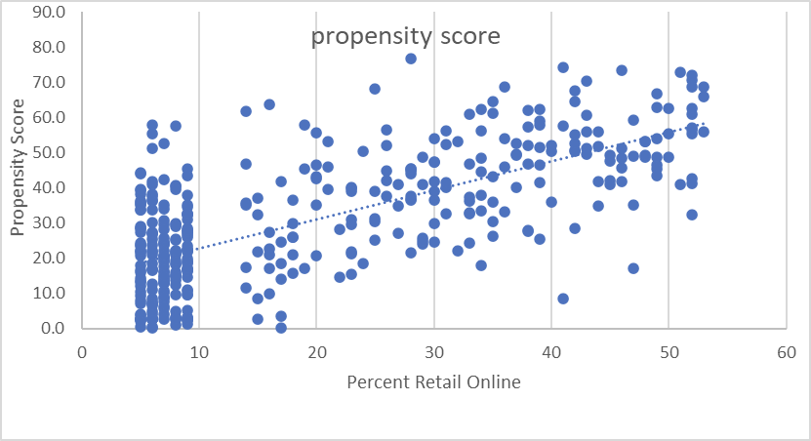
Factors lead to propensity to buy mattresses online
y = Intercept + 5.5B1 +3.99B2 +3.77B3
Y: propensity of buying mattress online
B1: Customers who owns Best Brand
B2: Customers' Income above 75,000
B3: Customers who owns DMC
Targeting on customers
who Best Rest Products
high Income
customer who own DMC mattress and percent retail online
Gender and Millennial is not the factor if individuals would buy online or not.
Note: 396 internet users aged 21+ who purchased a mattress in last five years or who plan to purchase next year. R Square = 0.52, F test<0.05

Slide 5
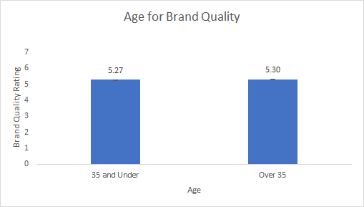
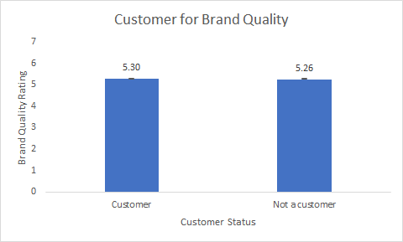
The perception of Best Rests Brand Quality is stronger with those over the age of 35 and those who are prior customers
Those over the age of 35 have a Stronger view on Brand Quality
Prior Customers have a stronger view on Brand Quality
Data Source: Best Rest Brand Study
The Brand Attitude page was used to create a One Factor ANOVA Test for Product Quality, Brand Trust, and Brand Quality across age, income, customer status, and gender. After this test only Brand Quailty had tests that were significant at .05, with Age being at .0408 and then Customer being just over .05 at .069.

Slide 6
Customer are more willing to buy online mattresses if they have a positive view of its quality
Get a good quality and comfort mattress are among top purchasing reasons.
Note: 819 internet users aged 21+ who purchased a mattress in last five years
Note: 947 internet users aged 21+ who purchased a mattress in last five years or who plan to purchase next year
Notes:
In this slide, we can see something in common from this simple sorting.
The reasons why they would like to buy a new mattresses. We can see that the highest one replace a worn out one, which is an inevitalbe situation
But when we look down to the second hightest, people want to have a new one is because they would like to pursue a better mattresses.
And from the bar chart on the right side, two of the top three reasons of purchae factors are in algnment with the reasons for purchases, that is have a good quality mattresses.

Slide 7
The top purchase factors for mattress owners are price, quality, and durability
For Best Rest customers, they Price, Comfort, Quality and Durability
With a Chi-Square Analysis, the only statistically significant factors for Best Rest customers are Price, Quality and Durability.
Quality Ho: Independent Ha: dependent
chi test | 3.94557
p-value | 0.04699
Price Ho: independent Ha: dependent
chi test | 10.2407
p-value | 0.00137
Durability Ho: Independent Ha: dependent
chi test | 26.8505
p-value | 2.2E-07
Note: 342 internet users aged 21+ who purchased a mattress in last five years.
Notes:
To dig deeper,
Looking at reaponses from internet users seperated by Best Rest Customer or non Best Rest Customer, we have done a chi-square analysis for those 13 factors to see what Best Rest Customer cares about when it comest to buy a new mattress.
By caculting with its expected value, there are only three factors among those factors demostrate statistically significant.
That is Quality, Price and Duarablity.
The resource didn't metion about the specific define of durablity, but in common sense, we could include durablity into quatlity factors.
Hence, for now, we can point out that Best Rest could be one of our target because the sleep cool's mattresss have good quality from our findings in previous project.

Slide 8


Consumers are MORE willing to purchase Mattress online GIVEN good quality, a strong warranty and comfort.
The willingness to purchase a mattress online is positively related with following three factors:
Good Quality
Strong Warranty
Comfort
The feature of trying before buy is not an important factor.
Data Source: Sleep Cool Study
The correlation between purchasing mattress online and the importance of quality, warranty and comfort are respectively 0.38, 0.36 and 0.35.
The correlation between purchasing mattress online and the feature of trying before buy is only 0.17.

Slide 9

consumers who buy mattresses online are willing to pay more for cooler mattress.
Positive correlation between willingness of buying mattress online and paying more for a mattress that sleeps cooler
Data Source: Sleep Cool Study
The correlation between paying more for sleeping cooler mattress and purchasing online is 0.45.

Slide 10
Comfortablitiy is the top Reason for owning a sleep cool mattress
SUMMARY OUTPUT
Regression Statistics
Multiple R | 0.6180337
R Square | 0.381965654
Adjusted R Square | 0.377703348
Standard Error | 1.276782091
Observations | 147
ANOVA
 | df | SS | MS | F | Significance F
Regression | 1 | 146.0875714 | 146.0875714 | 89.61479271 | 7.46882E-17
Residual | 145 | 236.3750137 | 1.630172508
Total | 146 | 382.462585
correlation | comfortable | support | pressure | hot | like
Sleep Cool | 62% | 44% | -38% | -44% | 63%
Casper(Bed in Box) | 51% | 43% | -41% | -59% | 72%
Tempu(Premium) | 57% | 48% | -39% | -47% | 64%
Note: 147 sleep test subjects aged 21+
F-test is less than 0.05, here is a statistically significant that people bought Sleep Cool mainly because its mattresses are comfortable.
Notes:
From Sleep Cool Customers' attitudes, with simply correlation of those five factors with rating of consideration of buying.
The highest part is comfortable.
Therefore, we made a regression between level of comfort and consideration to buy. A statistically significant came out.
But the most interesting part is no matter which the brand is (like casper or tempu’s cutomers) they all have obvious positive correlation with consideration of buying.
So, sleep cool could also aim at people care about comfortable when they would like to promote their mattresses.

Slide 11
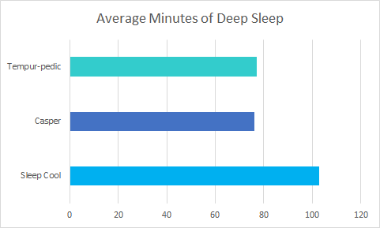
Best rest Should market its performance in providing better temperature regulation
What does 1 degree of mattress temperature mean?
Over 25 minutes more deep sleep!
11 fewer minutes awake on average
Net Sleep Cool sleep time benefit only ~10 minutes
 | Temperature | Total Sleep | Deep Sleep | Time Awake
Sleep Cool | 90 | 289 | 103 | 28
Casper | 91 | 305 | 76 | 39
Tempur-pedic | 91 | 304 | 77 | 39
Data source: Sleep Cool Study
Notes:
- Average minutes deep sleep from Sleep Cool study and validated by multivariate regression analysis of deep sleep’s performance against its competitors.
Regression Statistics
Multiple R 0.361483127
R Square 0.130670051
Adjusted R Square 0.118596024
Standard Error 0.40051271
Observations 147
ANOVA
df SS MS F Significance F
Regression 2 3.472054375 1.736027188 10.8224083 4.18113E-05
Residual 145 23.09910209 0.160410431
Total 146 26.57115646
Coefficients Standard Error t Stat P-value Lower 95% Upper 95%
Intercept 88.92234897 0.306977009 289.6710382 4.5344E-201 88.31558587 89.52911207
Deep Sleep 0.01102289 0.002381437 4.628672416 8.14002E-06 0.006315802 0.015729979
Awake 0.009652568 0.003212609 3.004588334 0.003137593 0.003302605 0.016002531

Slide 12
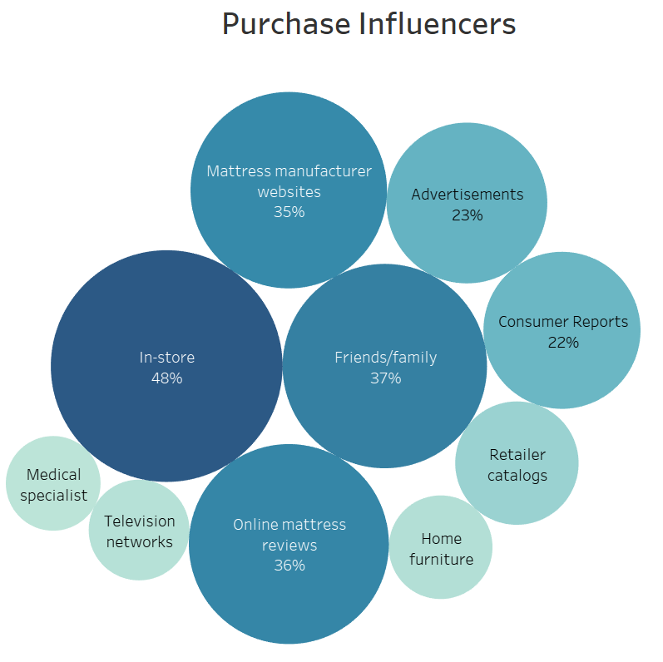
Family/Friends, online mattress reviews, mattress manufacturer websites are the top purchase influencers
Factors for selecting mattress brands
Friends/family
Online mattress reviews
Mattress manufacturer websites
Suggested marketing strategy
Friends/family referral offers
Advertisement on review websites
Data Source: Mattress Industry Report
Customers responses on where they get information about mattress and mattress purchasing

Slide 13
Conclusion
Best Rest should target prior customers, those with higher incomes, and those who have previously bought a mattress online and should market their products comfort and quality to these groups.
Best Rest has a strong reputation with customers who have higher incomes and are prior customers
Best Rests Brand Quality is a key factor for those with high incomes and that are prior customers
Best Rests comfort, quality , and strong warranty program are important for online customers
Sleep Cool’s proprietary technology has been proven in testing
Average sleep/wake times are ahead of its competitors
Positive perception of comfort, temperature regulation and support

